Slide 1
Assignment 2 Hints

Slide 2
Lab 2.1

Slide 3
Getting Started
Open Scratch Buffer
Run 'emacs'
From inside emacs session, open scratch buffer (C-x b then enter)
Type a LISP expression, and evaluate with C-j
Try (+ 1 2) to start or something simple

Slide 4
Using expt to check 2^3^4
If a number fits within a 64 bit signed integer, it needs to be less than 2^63
You can write this as a simple LISP expression.
(if (…)
t
nil)
Without relying on the code try to think whether 2^3^4 fits within 63 bits

Slide 5
Checking function meanings
Mostly follow instructions here, try to experiment when in doubt
If you have trouble using the M-SPC hotkey,
You can access the description through the C-h b menu
You can use the function directly by name with 'M-x just-one-space'

Slide 6
Lab 2.2

Slide 7
DISCLAIMER
The next slide shows a simplified implementation of what-line
It is a bit different than what is found in Emacs. There is some syntactical changes, but the main thing is the Emacs version accounts for a separate case where the buffer is "narrowed".
You do NOT need to account for this case, so feel free to use the next slide as a basis to begin your lab 2.2 work

Slide 8
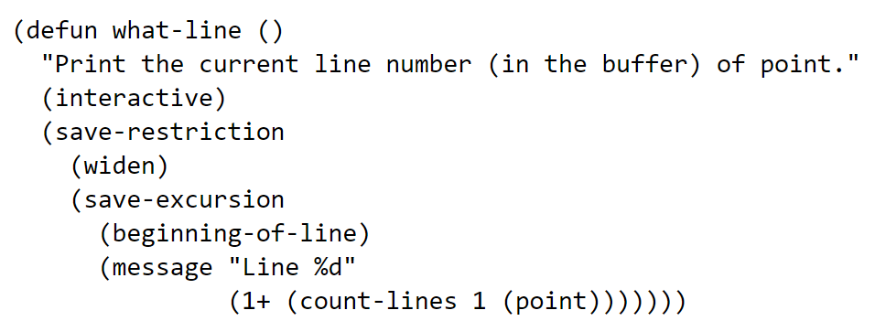
M-x what-line
Important things to look at
(interactive) -> means user can call it from emacs
Calls a 'count-lines' function
Point is a predefined function
There is a set of terms, "save-restriction", "widen", "save-excursion" which deal with if a user "narrows" the region of the page. See more here

Slide 9
Other built-in functions which are useful
point-min
The "minimum" point of the page/narrowed region
Usually 1, but maybe different if page is narrowed
point-max
The "maximum" point of the page/narrowed region
Usually (1+ (buffer-size)) but maybe different if page is narrowed
line-number-at-pos
Gives you the line number of your current position
Defined right below "what-line" in simple.el
char-before
Given a location, determines the character (value) before that location

Slide 10
So how to create which-line?
Try to use as much of the built-in LISP parts as possible so you don't worry too much
Use "what-line" as a base, and need to modify it so that it:
Counts total lines in the page/region
Minus one from that number if the last character is not a newline
Print current line out of total number of lines
Load into emacs, and test!
M-x load-file filepath
M-x which-line

Slide 11
Homework

Slide 12
The Goal
Write a Python 3 Script that has roughly same behavior as the shuf command
Check man shuf
When in doubt, try shuf command to check behavior of various scenarios
How will you call your script?
python3 /path/to/shuf.py [OPTIONS]

Slide 13
Terminology
Optional Arguments
Start with single or double hyphens
May have 0 or more values specified
Usually, any order is valid
Positional Arguments
No hyphens
Meaning comes from location in the command, after processing optional arguments
Can still be "optional" in the sense that a user does not need to provide it
shuf –n 5 file.txt
-n is an optional argument with value 5
file.txt is a positional argument, which comes after shuf

Slide 14
Better understanding the specs
Spec Says:
Your program should also support zero non-option arguments or a single non-option argument "-" (either of which means read from standard input), or a single non-option argument other than "-" (which specifies the input file name).
What that means:
Other than the optional arguments (-e, -i, -n, -r, --help) shuf.py takes no positional arguments or one positional argument. In the case of one positional argument, than it must be either a filename or the "-". In the case of "-", then the behavior is the same as not providing a positional argument which is that shuf.py should read from stdin.

Slide 15
Some basic examples
python3 shuf.py
Script reads from stdin, so you can type multiple lines (each followed by enter), and then hit Ctrl-D to indicate end of input. The program will print the input lines in random order
python3 shuf.py -
Same as above
python3 shuf.py FILE
The script will read all the lines from the file, and print them out in a random order
python3 shuf.py --head-count (or -n) COUNT
Can be combined with the above positional arguments. Should observe the same behavior, but only printing COUNT number of lines

Slide 16
Argparse
To parse the arguments, you'll want to use the Argparse library
Tutorial: https://docs.python.org/3/howto/argparse.html
Reference Docs: https://docs.python.org/3/library/argparse.html
Things to look for:
Argparse generates a usage message for you. That can be enough as long as you provide the string describing each argument
Optional vs Positional Arguments are defined by the name. Optional arguments have a – in front
Nargs will be a useful option to look at

Slide 17
Starting Point
Check commented version of randline.py on CCLE for details on what each line/function does.
You can use the below as a Python3 and ArgParse starting point

